Slide 1
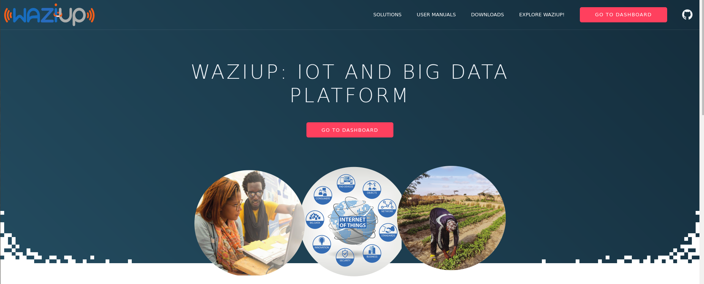
Rapid prototyping for your IoT applications!

Slide 2

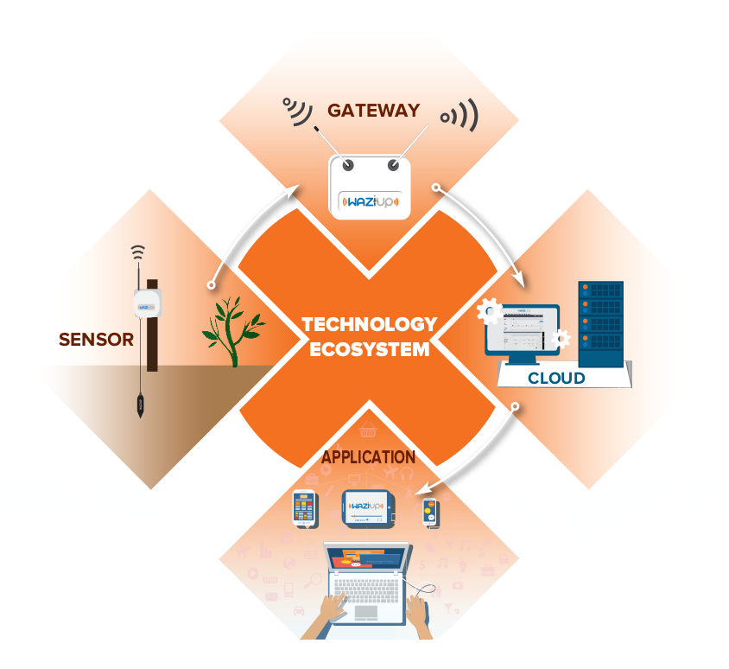
Rapid prototyping for your IoT applications!
Low cost
Long range with LoRa network
Works with or without Internet!

Slide 3
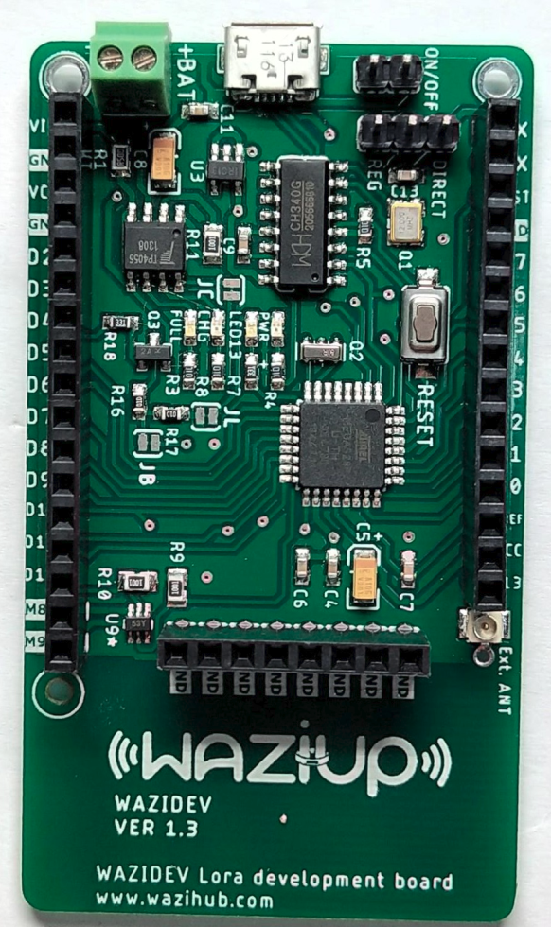
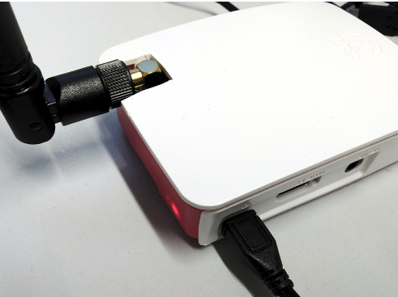
Our technology
WaziDev: IoT LoRa development board
Sensing and actuating platform for your applications!
Send your data up to 7 Km
Notes:
First section after header

Slide 4
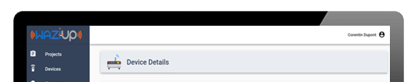
WaziGate: IoT LoRa Gateway and Edge platform
Works even without Internet
Can host your applications locally!
Notes:
First section after header

Slide 5
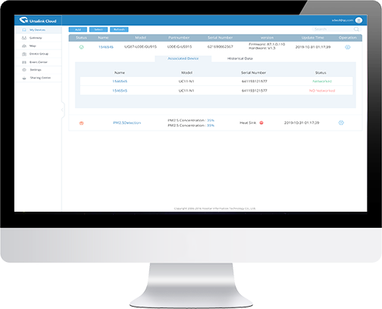
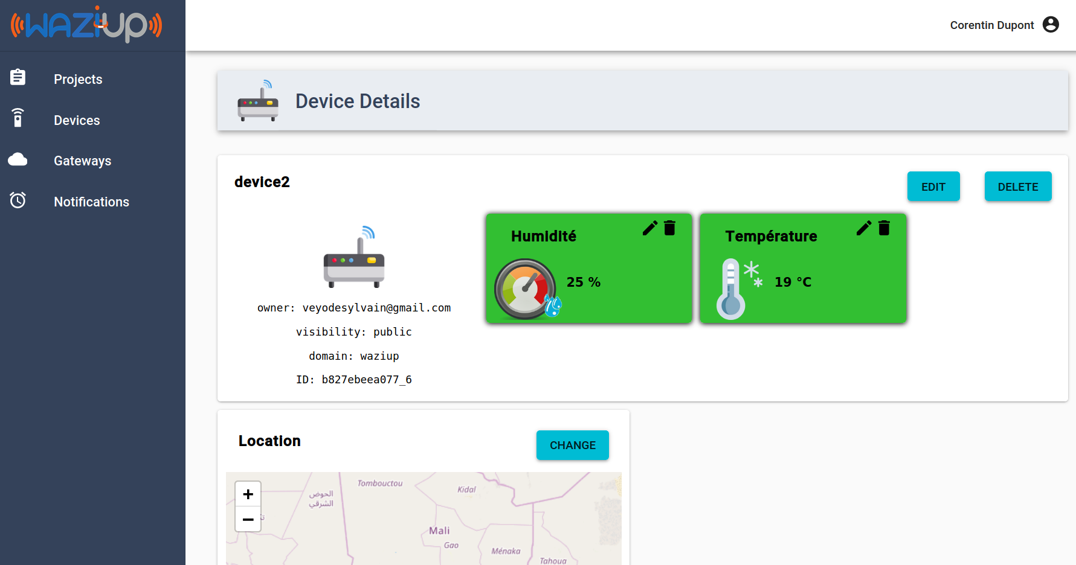
WaziCloud: IoT Cloud Platform and dashboard
Remote control of your application
Open API for IoT application development
Notes:
First section after header

Slide 6
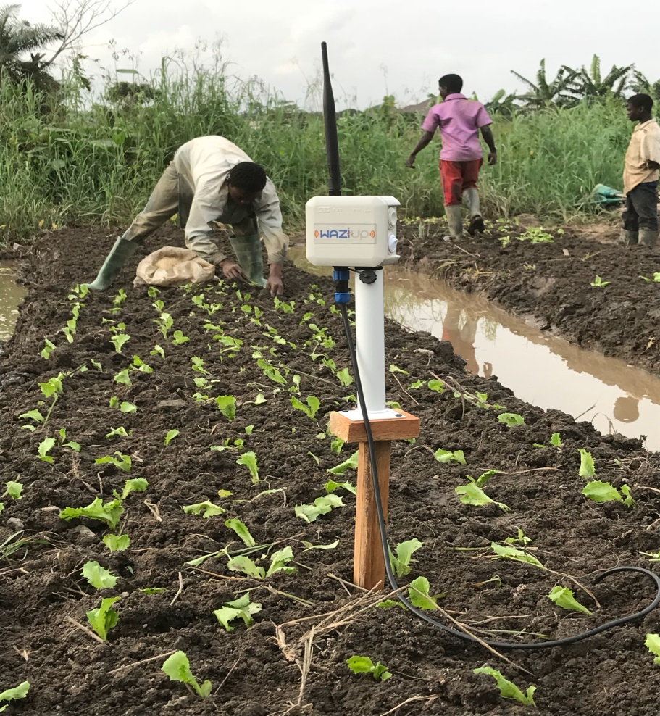
Use cases
Waziup can be used in:
Agriculture
Water management
Logistics…
The possibilities are endless!

Slide 7
